Slide 1



Slide 2
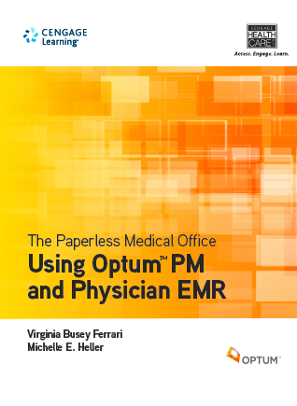
Optum/ Ferrari/Heller, The Paperless Medical Office
ISBN: 9781133278955
Pub Date - 5/7/2014
© 2015
8 ½” x 11”
4-Color
Spiralbound
720 pages
Notes:
Make mention of ebook/epin option
Used book option

Slide 3
Optum/ Ferrari/Heller, The Paperless Medical Office
Fully online
Includes front/back office
coverage
ICD-10 coverage
30-40 hours of activities
Notes:
Our newest EHR solution is Optum/ The Paperless Medical Office. This solution publishing in early May includes the Optum PM and Physician EMR software that is fully online, both front and back office, and has ICD-10 codes. This book provides students with 30-40 hours of practice and activities.

Slide 4
The Paperless Medical Office Workbooks
The Paperless Medical Office Workbook: Using Optum PM and Physician EMR, ISBN-13: 9781133279037
BBD: 5/2014
20-25 hours of activities
The Paperless Medical Office for Billers and Coders: Using Optum PM and Physician EMR, ISBN-13: 9781133279013
BBD: 8/2014
8-10 hours of activities
Notes:
We also have 2 workbooks available, one that is just the activities from the core book and a second workbook that is Billing and Coding activities using the software.
There is also a number of instructor resources available for this solution including testbanks, powerpoints, sample lesson plans and syllabus, and more.
The next couple of slides just feature a few screenshots to illustrate the software.

Slide 5
Why is Optum a great solution?
It’s a fully ONLINE program, which makes it completely portable
12 months of access
Can work at school and at home without losing any work!
It’s a real world application currently in use by thousands of practitioners
It provides a true hands-on simulation of what will actually be encountered in a medical office

Slide 6
Customer Feedback from Focus Groups
“I love the patient education materials. You can print these out, and these are the things that students will actually read because these are more office like.”
“This is really great, especially with the case studies. This is good for the students to be really informed on this system.”
“It’s awesome that Optum™ PM and Physician EMR is online. That’s really the best thing. That’s one of the main things-if you have the best product in the world and it’s not online, I won’t use it.”
“I really like it. I love how the training videos are in there, that’s amazing.”
“I would definitely adopt! I haven’t seen the book, but the software itself is really nice.”
“It’s very user friendly, very realistic for when they begin working or on their externship, very easy for them to learn.”
“Very user friendly. Students can easily follow instructions to perform the activities without a lot of one-on-one assistance.”

Slide 7
EHR Questions
How are you addressing EHR in your Medical Assisting courses?
Do you have a separate course?
Is it included in another course?
What certification standards are you focusing on in regards to EHR?
How do you help your students develop critical thinking skills?
Professionalism skills?

Slide 8
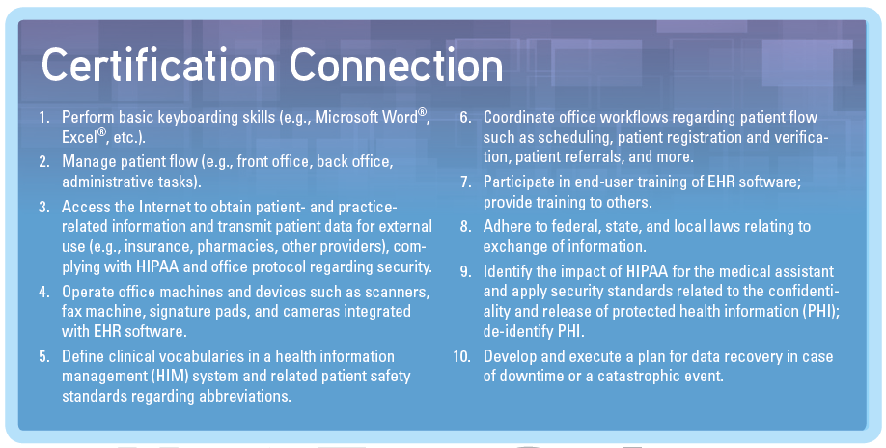
Features
Certification connection feature in each chapter links material to CAAHEP, ABHES and CEHRS standards.
Notes:
The certification connection feature highlights sample competencies that are covered in each chapter for a generic EHR certification exam.

Slide 9
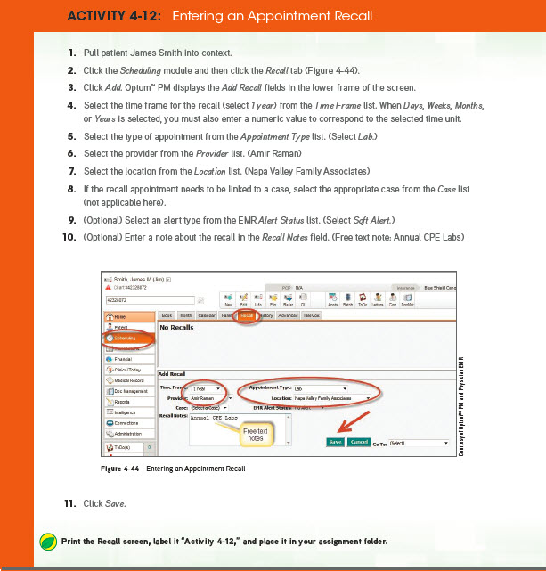
Features
Walks students through the various functions of the Optum PM and Physician EMR system in step-by-step activities.
Annotated screenshots allow students to check their work.
Notes:
Mention screen shots

Slide 10
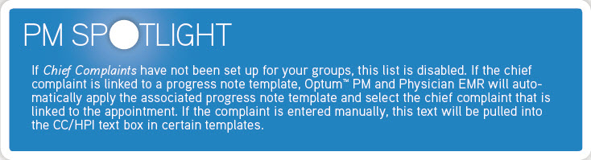
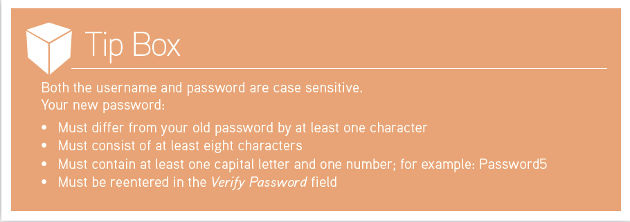
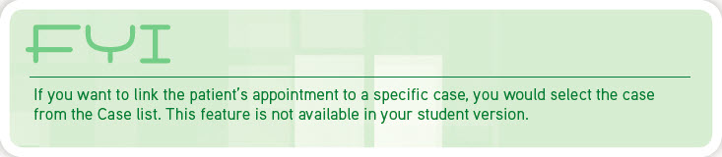
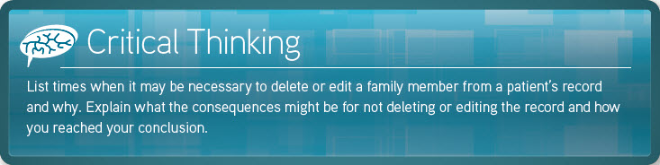
Features
Special feature boxes included throughout the text, such as:
Spotlights
Tip Boxes
FYI Boxes
Critical Thinking Questions
Notes:
Spotlight boxes highlight important material included throughout the text. There are different types of spotlight boxes, depending on the information being presented, such as Administrative, PM, Clinical, and Legal.
Tip boxes provide helpful hints for using Optum.
FYI boxes provide details on functions of Optum that are available in real-word settings are but are not available in the student version of Optum.
Critical Thinking boxes help students think about and deal with issues they may face on the job.

Slide 11
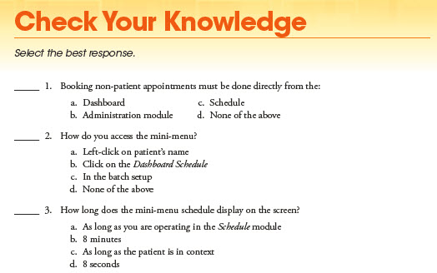
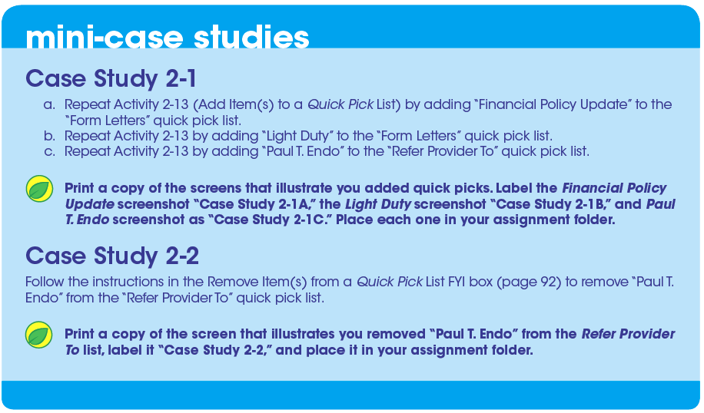
End-of-Chapter Features
“Check Your Knowledge” quizzes allow students to review what they’ve learned.
Mini-case studies provide additional practice, without the benefit of step-by-step instructions.

Slide 12
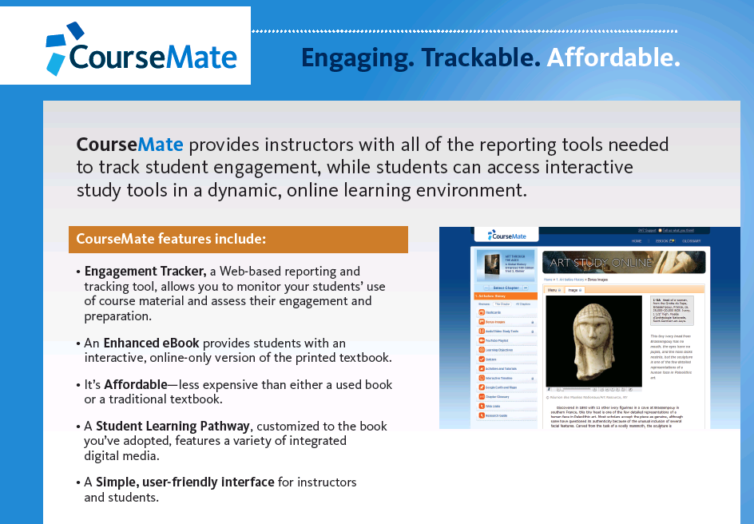
Digital Solutions: CourseMate
Notes:
Just standard stuff: eBook, quizzing, crossword puzzle

Slide 13
Instructor Support
Engagement Services
Instructor’s Online Companion
PowerPoints
Test Banks
Lesson Plans
Syllabus
Answer Keys to chapter activities and case studies, as well as Critical Thinking boxes and end-of-chapter quizzes
CAAHEP/ABHES Mapping
Errata and Text Updates

